Slide 1

(Not) talking about Polymer
Once upon a time there was a young JS library with a death wish
https://en.wikipedia.org/wiki/Ophelia_(painting)

Slide 2
So now you are a front-end developer?

Slide 3

Catholic wedding syndrome
Lock-in – very expensive to change
Seriously ask your lawyer
Does not play well with alternatives
Yea, you want just to grab some handy stuff from other …
End less fight between frameworks
Bad cooperation
Duck tape integration
Ok let’s use an <iframe>
The ultimate peacemaker

Slide 4
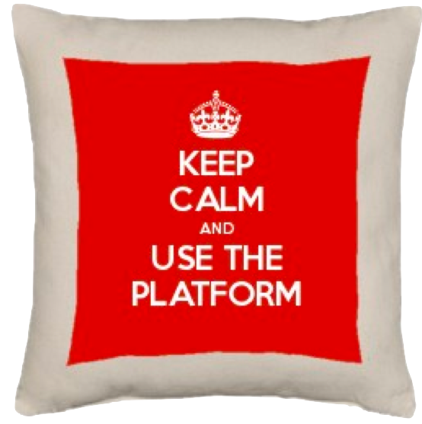
Is there a better way?
WEB Components

Slide 5
Is there a better way?
WEB Components!
WEB Components

Slide 6
http://localhost:8081

Slide 7
The four pillars of Web components
Custom Elements
Shadow DOM
HTML Template
HTML Imports
Native ES Modules
https://www.webcomponents.org/introduction
Notes:
Custom Elements
The Custom Elements specification lays the foundation for designing and using new types of DOM elements.
Shadow DOM
The shadow DOM specification defines how to use encapsulated style and markup in web components.
HTML imports
The HTML imports specification defines the inclusion and reuse of HTML documents in other HTML documents.
HTML Template
The HTML template element specification defines how to declare fragments of markup that go unused at page load, but can be instantiated later on at runtime.

Slide 8
So what is this Polymer stuff you are not talking about?

Slide 9
According to the authors …
Polymer is a lightweight library that helps you take full advantage of Web Components.
PolymerElement
Data binding
PropertyEffects
Helper to more easily stamp the template
Template Stamp
Getters and setters, property changes
PropertyAccessors
The native HTML element of the browser
HTMLElement
https://www.polymer-project.org/

Slide 10
MENU - https://www.webcomponents.org/element/casper2020/casper-context-menu

Slide 11
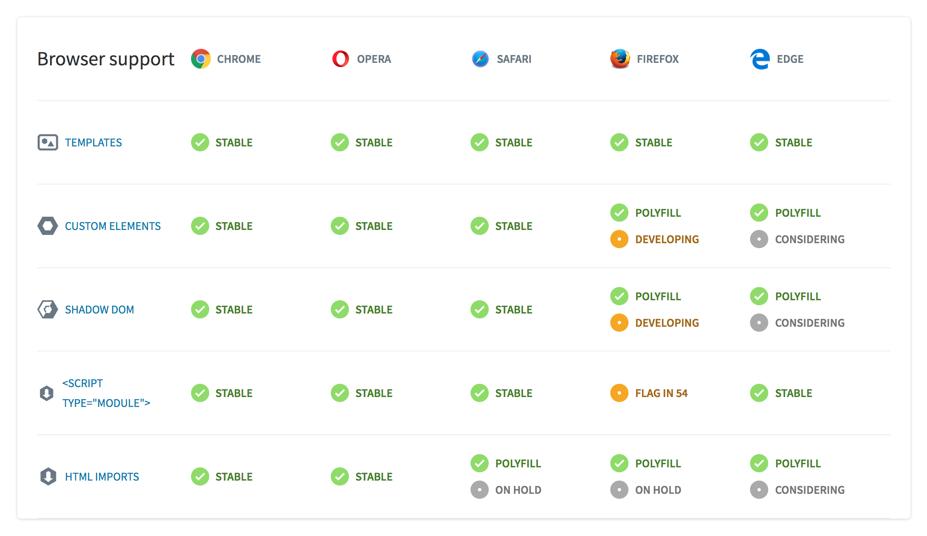
Can I use this in production?
https://www.webcomponents.org/polyfills

Slide 12
Can I use this in production?
Just one more thing …
We are writing ES6 code
Three options to serve:
HTTP/2 Push
ES6 Bundled
ES5 Bundled (transpiled)

Slide 13
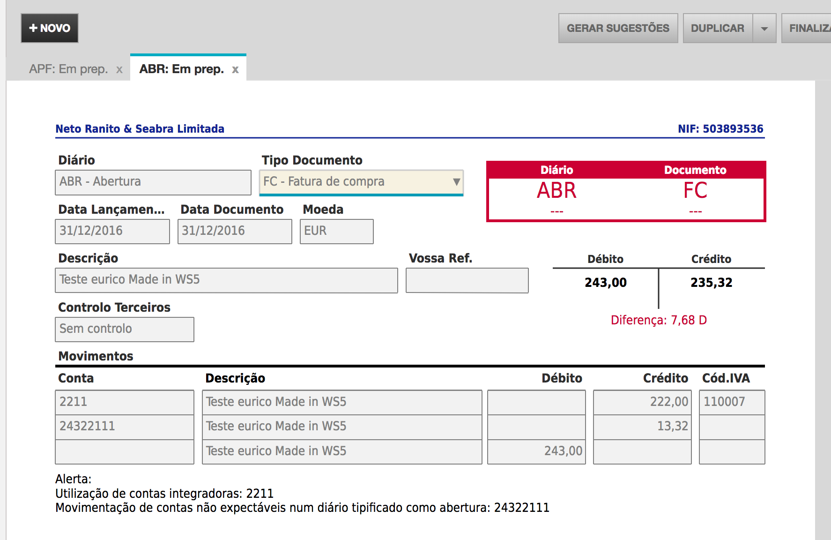
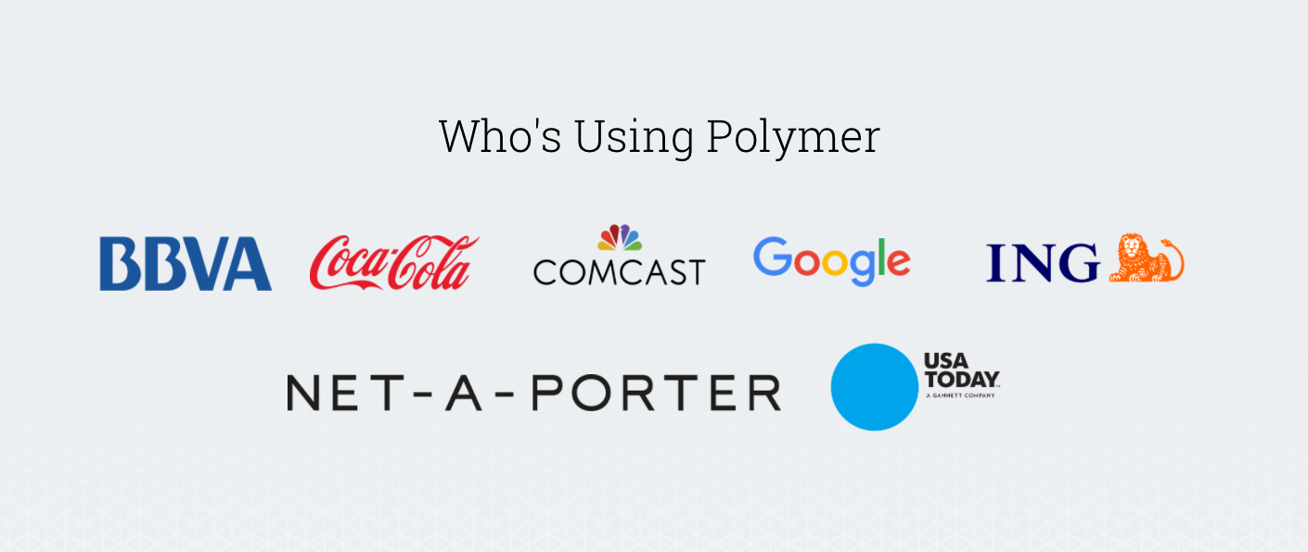
Do we use this on production?
Cloudware main project is toconline.pt
It’s a big web application
We use polymer 1.0 on about 3% of the site
<iframe> used to avoid problems with older libs
ES5 bundles compatible with IE11
New developments are in Polymer 2.0 (ES6)
Will soon take over the main page and navigation
Old code goes to <iframe>
Distribute ES5 and ES6 bundles (HTTP/2 push latter on)
Eventually the whole webapp will migrate to Polymer
Other notable users
https://www.youtube.com/new
https://hnpwa.com/

Slide 14
Why is Google working on Angular and Polymer?
Essentially where Angular 2 aims to create a custom framework, Polymer aims to bridge features until they are natively available in browsers. Traditionally JavaScript has been used to bridge functionalities like this, but the goal of Polymer is essentially to use less JavaScript and let native browser features take this over.
Source https://react-etc.net/entry/why-is-google-working-on-angular-2-and-polymer

Slide 15
Thanks
http://www.cloudware.pt
https://www.linkedin.com/in/euricoinocencio/

